Slide 1
Introduction to TensorFlow
Wenjian Huang huangwenjian@ppmoney.com
July 13, 2017

Slide 2
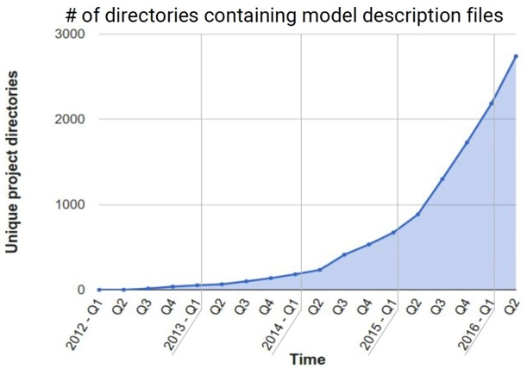
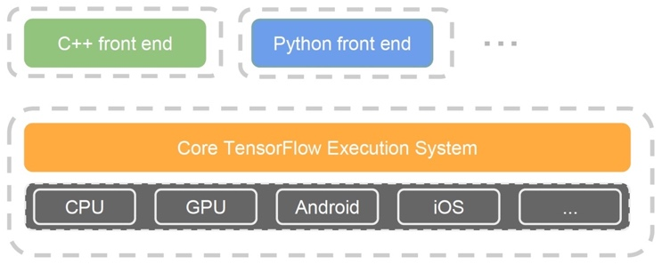
What is TensorFlow
TensorFlow ¹ is an interface for expressing machine learning (not only deep learning) algorithms, and an implementation for executing such algorithms.
code: https://github.com/tensorflow/tensorflow models: https://github.com/tensorflow/models
¹www.tensorflow.com

Slide 3
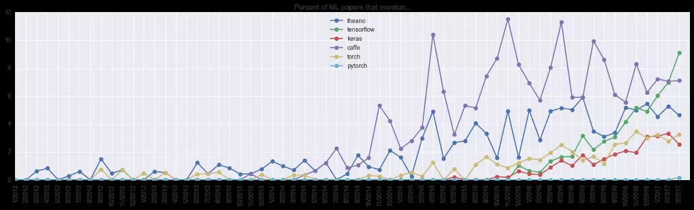
Trending in TensorFlow and other Deep Learning Frameworks
Released in 2015 November
Top 1 Machine Learning / Deep Learning / Python Project in GitHub
More users than other frameworks and better documentations

Slide 4
Comparison with other Frameworks
Frameworks | Organizations | Supported Languages | Stars | Forks | Contributors
TensorFlow | Google | Python/C++/Go/.. | 62660 | 30339 | 936
Caffe | BVLC | C++/Python | 18870 | 11587 | 247
Keras | fchollet | Python | 17278 | 6169 | 484
CNTK | Microsoft | C++/Python | 11662 | 2953 | 135
MXNet | DMLC | Python/C++/R/... | 10280 | 3848 | 380
Torch7 | Facebook | Lua | 7060 | 2098 | 129
Deeplearning4J | DeepLearning4J | Java/Scala | 6889 | 3299 | 119
Theano | U. Montreal | Python | 6584 | 2191 | 310
PyTorch | Facebook | Python | 5720 | 1072 | 248
Caffe2 | Facebook | C++/Python | 5127 | 1056 | 93
PaddlePaddle | Baidu | C++/Python | 5072 | 1342 | 71
Sonnet | DeepMind | Python | 5040 | 598 | 11
Neon | NervanaSystems | Python | 3092 | 675 | 62
updated on July 6, 2017

Slide 5


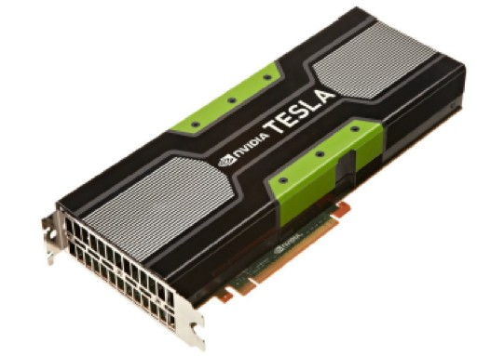
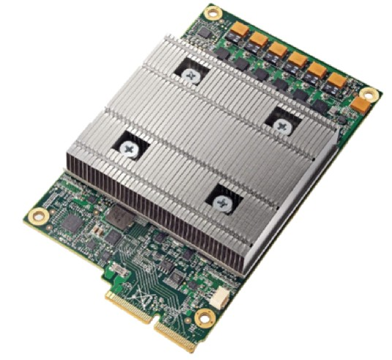
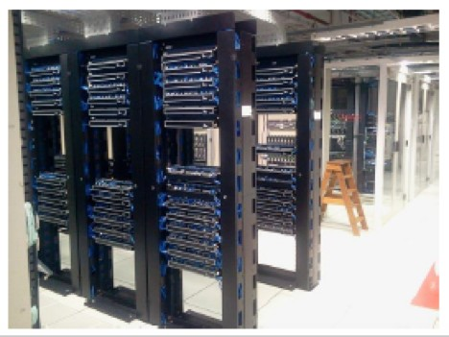
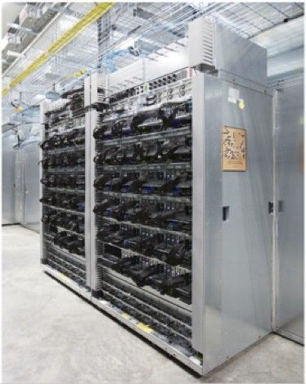
Start Up
The Google Brain project started in 2011 to explore the use of very-large-scale deep neural networks :
▶ DistBelief : the first generation scalable distributed training and inference system
▶ TensorFlow : second-generation system for the implementation and deployment of large scale machine learning models
TensorFlow Research Cloud (1000 TPUs, free for top researcher)
https://www.tensorflow.org/tfrc/

Slide 6
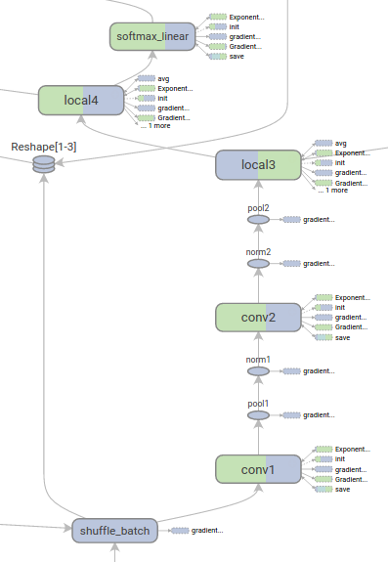
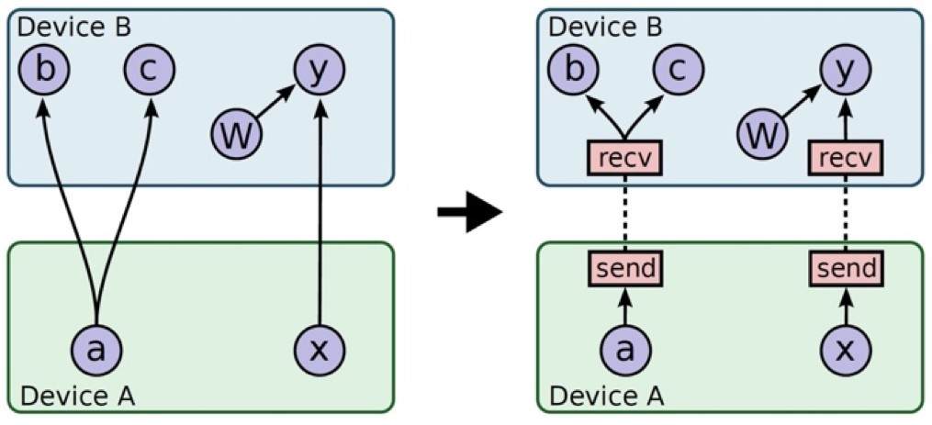
Data Flow Model
Data flow graphs describe mathematical computation with a directed acyclic graph (DAG) of nodes & edges, allowing some kinds of nodes to maintain and update persistent state and for branching and looping control structures.

Slide 7
Programming Model
Basic Concepts
▶ Operation : An operation has a name and represents an abstract computation. (e.g., “add” and “dot product”)
▶ Kernel : An implementation of an operation that can run on a particular type of device. (e.g., “CPU” and “GPU”)
▶ Session : Sessions manage and execute TensorFlow computation graphs. Therefore, client programs interact with the TensorFlow system through sessions.
▶ Tensor : A n-dimensional array that flows along the edges of the computation graph.
▶ Variable : A special kind of operation that returns a handle to a persistent mutable tensor that survives across executions of a graph.
Programming Steps
Represents computations as graphs.
Represents data as tensors.
Maintains state with Variables. Uses feeds and fetches to get data into and out of arbitrary operations.
Executes graphs in the context of Sessions.

Slide 8
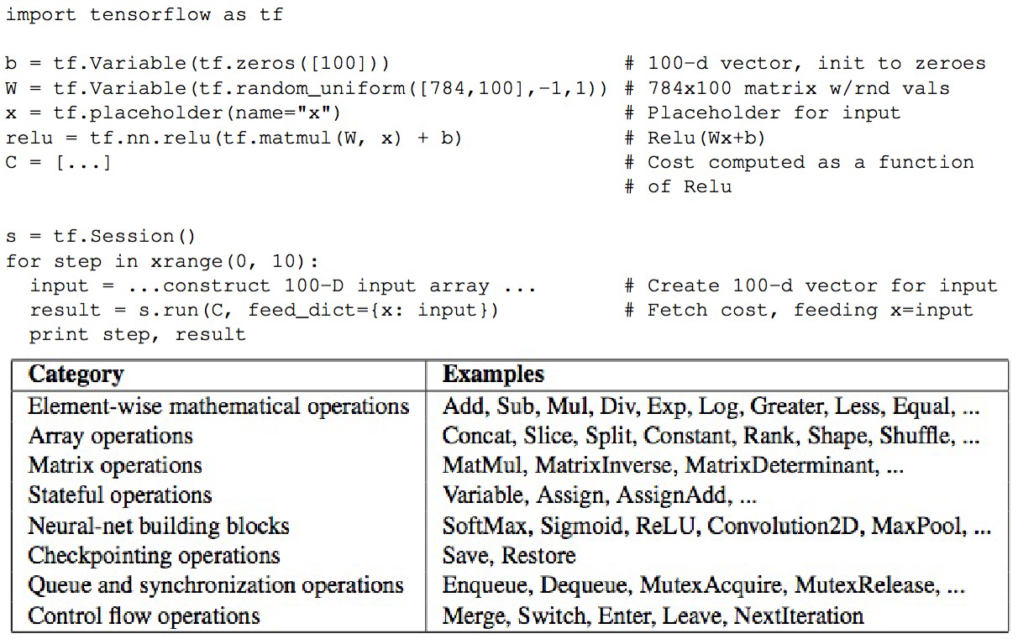
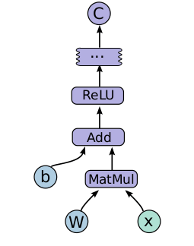
Code Example

Slide 9
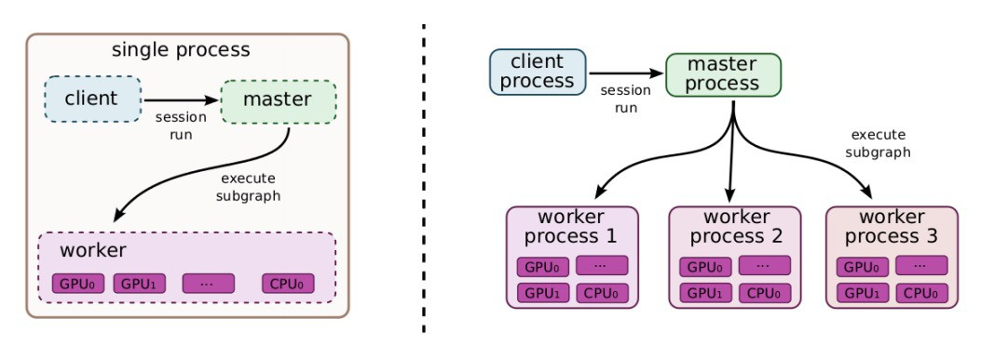
Underlying Implementations
The main components in a TensorFlow system are the client, which uses the Session interface to communicate with the master and one or more worker processes, with each worker process responsible for arbitrating access to one or more computational devices (such as CPU cores and GPU cards).

Slide 10
Extensions
▶ Automatic Diﬀerentiation : Automatically computes gradients for data flow graphs.
▶ Partial Execution : Allows TensorFlow clients to execute a subgraph of the entire execution graph.
▶ Device Constraints , Control Flow, Input Operations , Queues , Containers · · ·

Slide 11
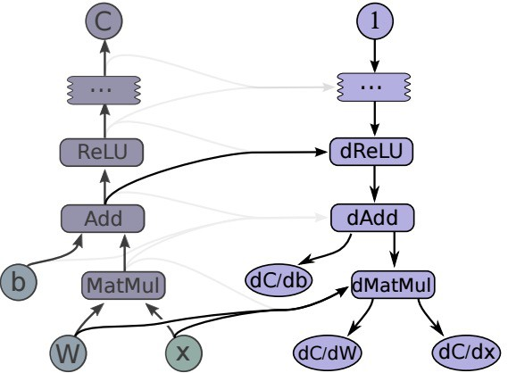
Gradient Computation
TensorFlow has built-in support for automatic gradient computation

Slide 12
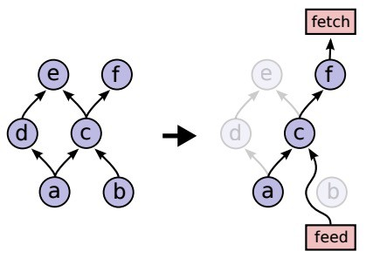
Partial Execution
To execute an arbitrary subgraph of the whole graph

Slide 13
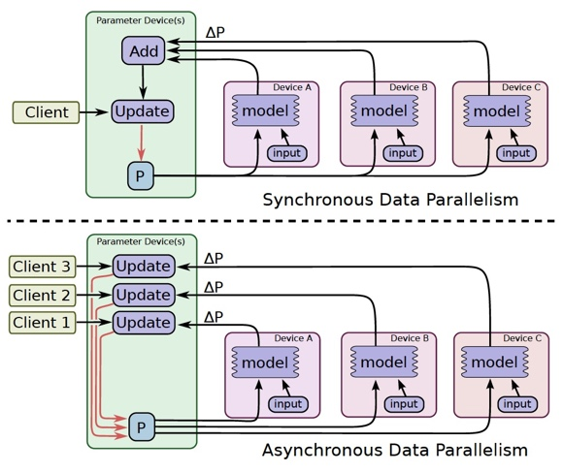
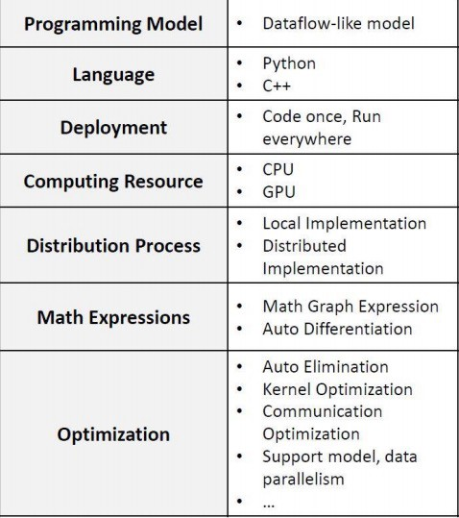
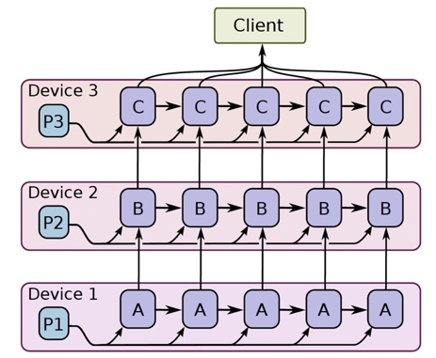
Features Summary

Slide 14
Multi-GPU in Single Machine

Slide 15
Distributed Training

Slide 16
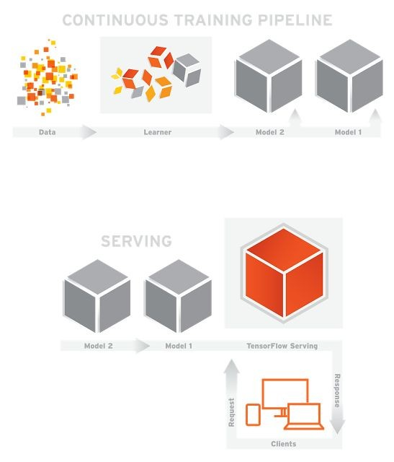
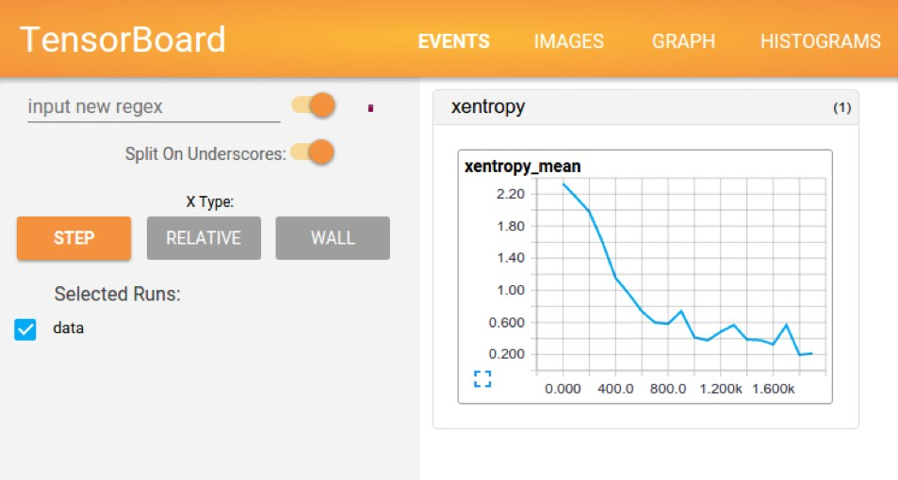
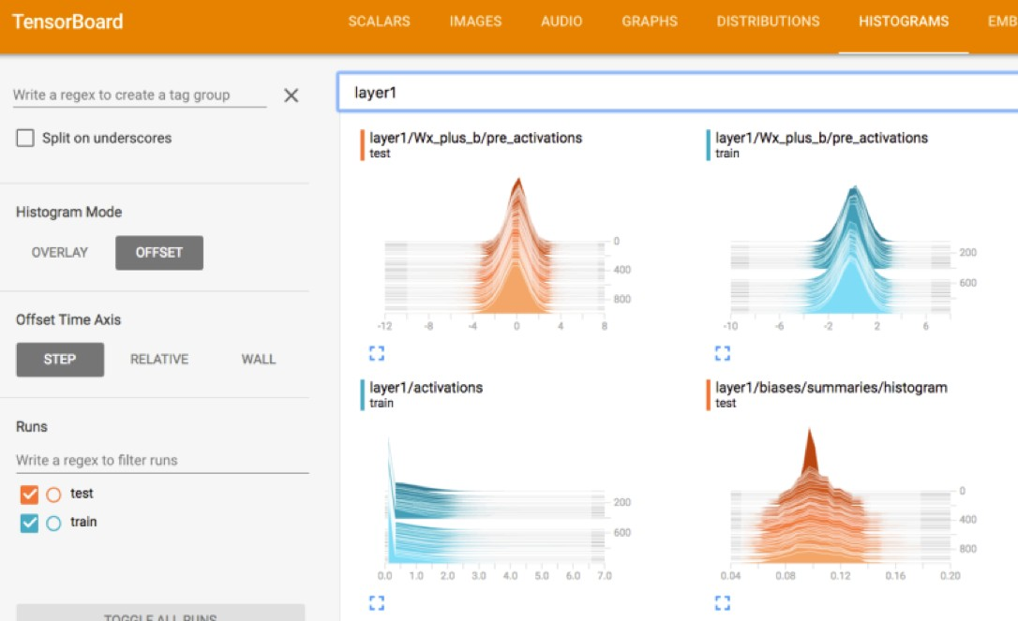
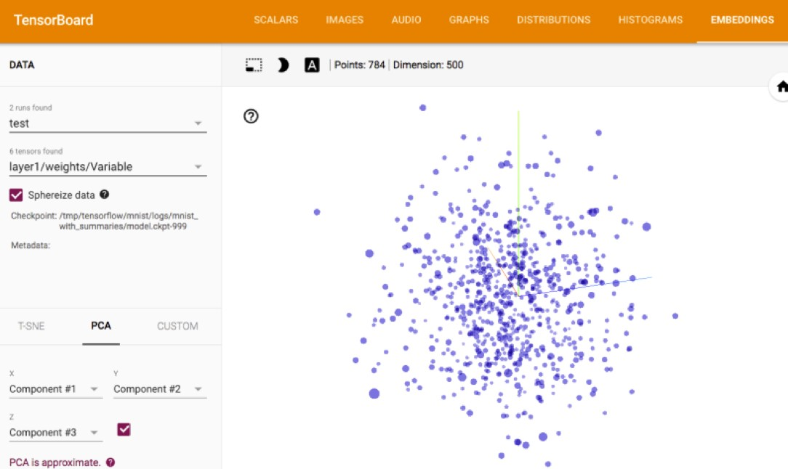
TensorFlow Serving & TensorBoard

Slide 17
Native API on FCN,CNN,RNN
FCN
W1 = tf.Variable(tf.truncated_normal([in_units, h1_units], stddev=0.1))
b1 = tf.Variable(tf.zeros([h1_units]))
W2 = tf.Variable(tf.zeros([h1_units, 10]))
b2 = tf.Variable(tf.zeros([10]))
hidden1 = tf.nn.relu(tf.matmul(x, W1) + b1)
y = tf.nn.softmax(tf.matmul(hidden1, W2) + b2)
CNN
W_conv1 = tf.Variable(tf.truncated_normal([5, 5, 1, 32], stddev=0.1))
b_conv1 = tf.Variable(tf.constant(0.1, shape=[32]))
def conv2d(x, W):
return tf.nn.conv2d(x, W, strides=[1, 1, 1, 1], padding='SAME')
def max_pool_2x2(x):
return tf.nn.max_pool(x, ksize=[1, 2, 2, 1], strides=[1, 2, 2, 1],
padding='SAME')
h_conv1 = tf.nn.relu(conv2d(x_image, W_conv1) + b_conv1)
h_pool1 = max_pool_2x2(h_conv1)

Slide 18
Native API on FCN,CNN,RNN
Embedding & LSTM
word_vectors = tf.contrib.layers.embed_sequence(features, vocab_size=n_words, embed_dim=EMBEDDING_SIZE, scope='words')
word_list = tf.unstack(word_vectors, axis=1)
cell = tf.nn.rnn_cell.BasicLSTMCell(EMBEDDING_SIZE)
outputs, state = tf.nn.static_rnn(cell, inputs=word_list, dtype=tf.float32)
Loss & Optimizer
cross_entropy = tf.reduce_mean(-tf.reduce_sum(y_ * tf.log(y),
reduction_indices=[1]))
train_step = tf.train.GradientDescentOptimizer(0.5).minimize(cross_entropy)

Slide 19
tf.contrib.layers(slim) API on FCN,CNN
Automatically set default activation_fn, weights_initializer, bias_initializer
activation_fn → tf.nn.relu
weights_initializer → initializers.xavier_initializer()
bias_initializer → tf.zeros_initializer()
layers = tf.contrib.layers # tf.contrib.slim
FCN
hidden1 = layers.fully_connected(x, h1_units)
y = layers.fully_connected(x,10,activation_fn=layers.softmax)
CNN
h_conv1 = layers.conv2d(inputs,num_outputs=32,kernel_size=[8,8],stride=[4,4],
padding='VALID')
h_pool1 = layers.max_pool2d(h_conv1, [2,2])

Slide 20
tf.contrib.keras API on FCN,CNN,RNN
keras = tf.contrib.keras
model = keras.models.Sequential()
FCN
model.add(keras.layers.Dense(h1_units,input_dim=in_units,activation='relu'))
model.add(keras.layers.Dense(10,activation=’softmax’)
CNN
model.add(keras.layers.Conv2D(32,[5,5],input_shape=[28,28,3]))
model.add(keras.layers.MaxPool2D())
RNN
model.add(Embedding(max_features, output_dim=256))
model.add(LSTM(128))
Loss & Optimizer
No need for explicit loss define, done by ’compile’ the model
model.compile(loss='categorical_crossentropy', optimizer=SGD(0.1))
model.compile(loss='mse', optimizer=Adagrad(lr=0.01,epsilon=1e-3))

Slide 21
TIPS
GPU Visibility: Sometimes you want the program to use a specific GPU
import os
os.environ["CUDA_VISIBLE_DEVICES"]="1"
Memory Growth: Allow GPU memory growth instead of using up all memory
config = tf.ConfigProto() config.gpu_options.allow_growth = True session = tf.Session(config=config, ...)
Reset the graph and re-run the training
tf.reset_default_graph()

Slide 22
TIPS
Make your result reproducible
import numpy as np
np.random.seed(0)
import tensorflow as tf
tf.set_random_seed(0)
Accelerate MLP
config = tf.ConfigProto()
config.graph_options.optimizer_options.global_jit_level = tf.OptimizerOptions.ON_1
sess = tf.InteractiveSession(config=config)

Slide 23
TIPS
Utilize queues instead of feed_dict, or preload all data into GPU memory using Variable when data is small
queue = tf.train.string_input_producer(["file0.csv","file1.csv"])
k, v = tf.TextLineReader().read(queue)
cols = tf.decode_csv(v)
coord = tf.train.Coordinator() threads = tf.train.start_queue_runners(sess=sess, coord=coord)
Preprocessing on CPU not GPU (save communication time, let GPU focus on training)
with tf.device('/cpu:0'):
preprocessing...
Fused Batch Norm and NCHW format, NCHW train faster on GPU through cuDNN, NHWC run faster on CPU during inference
bn = tf.contrib.layers.batch_norm( input_layer, fused=True, data_format='NCHW' scope=scope, **kwargs)

